Slide 1
Gilbert Motors
RFP Solution Document

Slide 2
About us
Scope of proposal/out of scope
Proposed logical architecture
Proposed Technical architecture
Assumptions
Risks and commercials
Project Plan
Table
of
content

Slide 3

TEAM Introduction
Name Role
Sonam -Engagement Manager
Abhirup Patil -Presales
Amol Otari -Presales Solution Architect
Ankur Sharma -Solution Architect
Phanindra Kumar -Technical Architect

Slide 4








About us
GLOBAL PARTNER:

Slide 5
Our understanding of Gilbert motors problem
Gilbert Motors is actively pursuing a demand-driven digital transformation initiative for all its factories, to be implemented in phases.
This transformative effort aims to automate critical business processes and concurrently reduce wastage and error rates through the deployment of robust enterprise planning and advanced analytics solutions.
With a market ambition to become the industry's leading demand-driven automotive manufacturer, Gilbert Motors is seeking a partner to deliver a demand-driven digital factory.
The partner is expected to enhance the operational accuracy of both systems and manufactured products, demonstrating capabilities with committed pricing and a constructive approach.

Slide 6
In-Scope and Out of Scope
In Scope | Out of Scope
Existing system study | Sunset\Decommissioning of existing warehouse
Design and implement Automation of key Operational Processes | Data Cleansing
Identification of improvement areas to eliminate wastage at Plant level | Buy new licence for software and Hardware
Warranty Analytics for Paint, Engine and Interior | Any quality issues in source data
AI integration from source systems, machines and analytics | End User Training
Use of agreed Modelling , Reporting and Planning Tools
Digital Transformation- Forecasting of demand Order to Ship Order to Cash Financial reporting

Slide 7
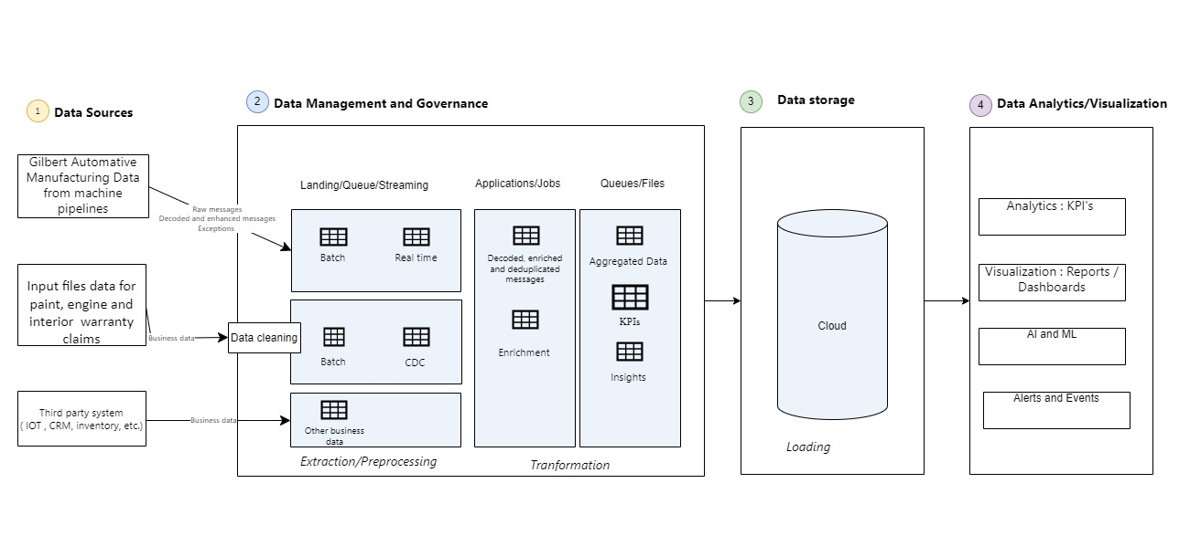
High Level LOGICAL Solution of Gilbert Automotive Digital Transformation

Slide 8













High Level Technical Solution of GM Digital Factories Data Platform
Data Sources
Data Ingestion
Data Storage-Landing Area
Data Processing & Transformation
Analytics & Report
Data Visualization
AI for Analytics and Chat Engine
SAP
Process
ADF-Batch Ingestion
Azure DataBricks
Oracle
PowerBI Dashboard
ADLS Gen2
ML Flow
External Application
ADB-Spark Streaming
Kafka Stream
Azure DataBricks Delta Lake
Business User
Store
API Management
Monitor and Govern

Slide 9
ASSUMPTIONS
General Assumptions
Gilbert will assign a project manager to work collaboratively with Vendor throughout the engagement
Key stakeholders from Gilbert will be available to participate in required meetings/workshops on a timely basis to understand the the current system.
Gilbert will make SMEs available for Q&A at discovery sessions as needed. (e.g. current ERP solutions, data warehousing solution , BI tools etc.)
Gilbert Motors will ensure the availability of Legacy system & teams for source data and mapping right from the project's commencement.
Gilbert will provide necessary access to relevant, complete and correct information, on existing applications, interfaces, infrastructure, capacity, performance, maintenance, and other relevant information required by Vendor to provide the Services
Gilbert Motors should make necessary preparations well in advance for data collection during the tight schedule of the digital transformation assessment.
Gilbert will provide customer/PII specific data which has any geo regulatory compliance.
Gilbert Motors will conduct User Acceptance Testing (UAT) and provide the necessary sign-off.
Assuming there will be 5-6 data sources and 100+ tables in scope, and based on that, 10+ Business Intelligence (BI) reports can be developed.
Planning and forecasting tools can be used separately.
Technical architecture and business requirements to be reviewed and signed off by Gilbert

Slide 10
Risks & Mitigation
Risks
Severity
Probability
Mitigation
1
Scope/Implementation changes during analysis phase.
We will follow change management mechanism to accommodate scope changes
2
Sign off on all deliverables by Gilbert Motors
Gilbert Motors will appoint SPOC and governance mechanism to review / approve and accept the deliverables on time
3
Delay in sorting issues at infra for required software's
Gilbert Motors will help to resolve issues with the infra
4
Unavailability of key stakeholders for approval and review
Gilbert Motors will ensure they will provide another stakeholder in absence of primary
5
Delay in Initial setup of application due to unavailability of required software and license
Gilbert Motors would provide the required support to mitigate the risk by obtaining the required software and license
6
Code logic change suggested as part of CR for the existing code after development phase is completed
Will be considered as part Change Management process and added to schedule and cost Evaluate option of freeze period for applications in the phase
7
Gilbert Motors to ensure test data for Digital Factoring is available at right time before the testing phase
7
Delay in availability of Test data for Digital Factoring

Slide 11

Commercials
Pricing for Proposed Solution, Based on the Scope and Assumptions outlined & GM has secured funding for entire digitalization’s,
Vendor’s proposes Fee as outlined below
Phase | Value Per Phase (US$) | No. of Features delivered*
Phase -I | $273,949 | TBU
Phase -II | $99,464 | TBU
Phase-III | $99,464 | TBU
Phase-IV | $151,049 | TBU
Terms and Conditions:
Validity: Prices quoted in this proposal are valid a period of 30 days from the date of submission
Taxes: All prices are exclusive of applicable taxes, which will be added at the time of invoicing.
Escalation: Pricing may be subject to periodic review and adjustment, with prior notice to the client.
Payment Schedule: A detailed payment schedule will be provided upon agreement, outlining milestone payments or invoicing intervals.
Proposal Exclusions
Licenses Costs: Licenses costs are not included in the proposed pricing.
Third-party Fees: Any fees associated with third-party services or integrations are not included in this proposal.
Travel Expenses: Travel expenses for on-site visits or training sessions are not included and will be billed separately
Acceptance Criteria:
The proposed pricing is contingent upon acceptance of all terms and conditions outlined in this proposal. Any deviations from these terms may result in adjustments to the pricing structure..

Slide 12
Indicative implementation plan
M0 | M1 | M2 | M3 | M4 | M5 | M6 | M7 | M8 | M9 | M10 | M11
Development
Analysis & Design
Analyze ETL, Dashboards & Data
Validate and agree on assumptions, dependencies
Team Onboarding
Kickoff/ A&D
Environment Setup
Installation/conf.
Configuration
Sizing
Develop, UT & Deploy
Development Activities
Data collection
Collecting data from sources related to our KPI
Model building/ KPI derivation
Building model around collected data for each KPI
Visualization building
Visualization to realize the KPI
SIT
Testing & Deployment
Test Case Creation
Test case creation
Test case execution after deployment
Defect Management
Test summary report
Deploy & Execution
UAT
UAT
UAT Execution
Defect management
Prod
Deployment & Warranty
Hypercare
Warranty Support
Platform support till end of warranty
Knowledge Transfer
Critical apps deploy
Non-Critical apps deploy

Slide 13

Data Validation and Reconciliation Testing Approach
Data Sources
Data Ingestion
Data Storage-Landing Area
Data Processing & Transformation
Analytics & Report
Data Visualization
AI for Analytics and Chat Engine
SAP
Process
ADF-Batch Ingestion
Azure DataBricks
Oracle
PowerBI DashBoard
ADLS Gen2
External Application
1
ML Flow
5
ADB-Spark Streaming
Kafka Stream
Business User
Azure DataBricks Delta Lake
2
3
4
1
Landing Zone validation
File format
File Naming convention
File Type & Its generated date
Valid Data
2
Bronze and Silver Zone Validation
Target to source reconciliation
Aggregation target
Store
API Management
3
Gold zone Validation
Business rule validation checks,
Target to source reconciliation
Aggregation of Target
BI Report/Dashboard:
Connection Validation
Validation of report if it is accessing data as expected format
4
5

Slide 14


Slide 15


